Slide 1
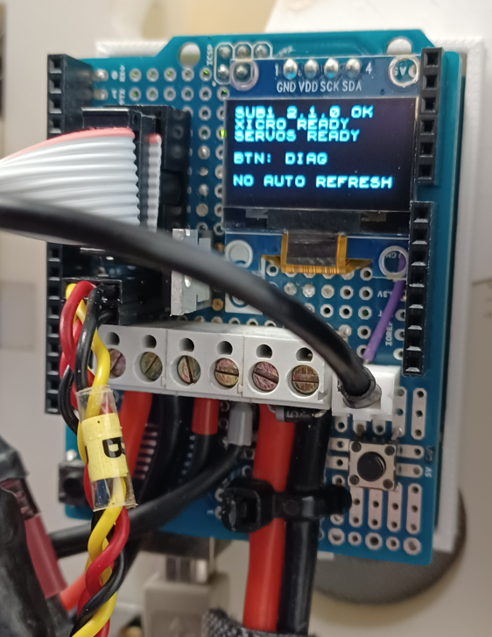
Servos C..J and current sensor
SUBSYSTEM_1
H (D4)
I (D3)
G (D5)
J (D2)
F (D6)
Not used
OLED
RIBBON CABLE
← H
← I
← G
← J
← F
← not used
← E
← current
← D
← C
E (D7)
Current
Sensor
D (D8)
C (D9)
GND
Signal
A B
Servo B (D10)
Shoulder
Signal
+
-
Servo A (D11)
Omoplate
Bicep position
Signal from pot
Main Power
A: Omoplate
B: Shoulder
C: Rotate
D: Bicep
E: Wrist (not used)
F: Pinky (finger)
G: Ring (finger)
H: Middle (finger)
I: Index (finger)
J: Thumb (finger)
Push-Button
Toggle data on OLED
RESET button

Slide 2
SUBSYSTEM_2
GND
Vin
RIBBON CABLE
← Brown (GND)
← Red (Vin)
← Orange (not used)
← Yellow (D13. Rothead)
← Green (D26. Jaw)
← Blue (D22. EyeX)
← Purple (D24. EyeY)
← Grey (not used)
← White (not used)
← Not used
Not used
D13. Rothead
D26. Jaw
D22. EyeX
D24. EyeY
Not used
Not used
Not used
Signal
+
-
D12. Neck
Main Power

Slide 3
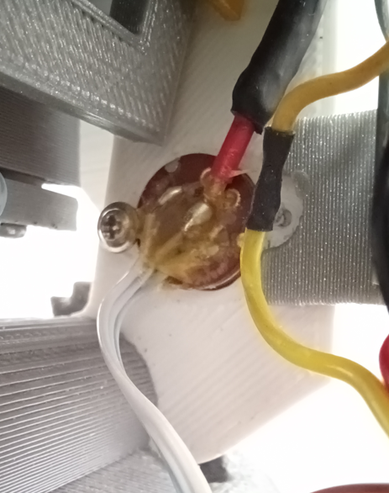
Shielded cable
To Subsystem1
Central terminal
To Servo (Bicep)

Slide 4
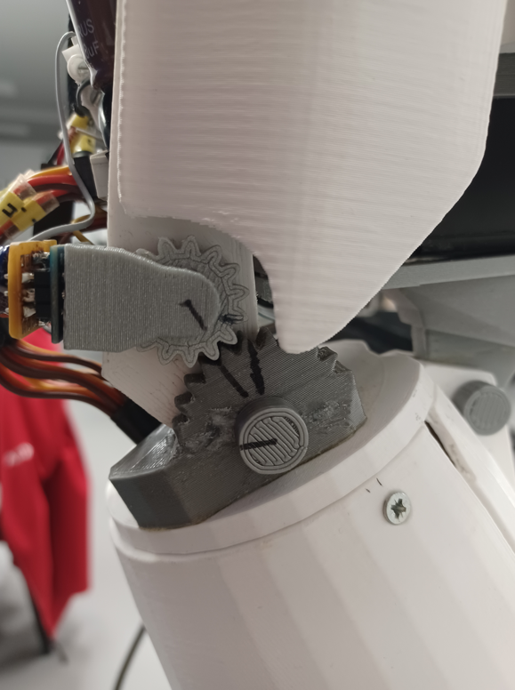

Slide 5
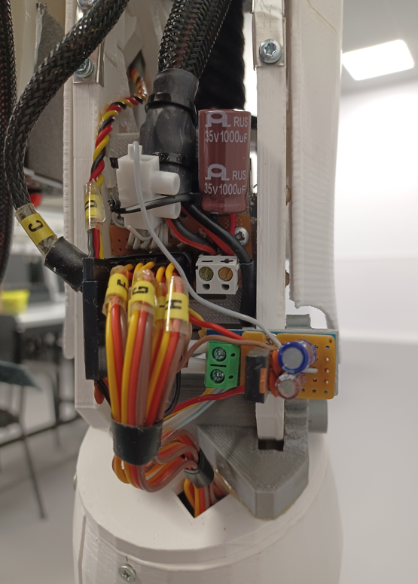
Current sensing
output (to Subsystem1)
Servos (C to J)
C D E F J G I H
Main power
Signal
+
-
C: Rotate
D: Bicep
E: Wrist (not used)
F: Pinky (finger)
G: Ring (finger)
H: Middle (finger)
I: Index (finger)
J: Thumb (finger)
Current sensing
module

